Slide 1
Aviation Incident Analysis for Safety Optimization: Identifying Risk Factors to Improve Aircraft Safety
PRESENTATION BY : LYDIAH KHISA
Linkedin: https://www.linkedin.com/in/lydia-khisa

Slide 2
Project Overview
This project focuses on assessing aviation incident and accident data to identify patterns, trends, and risk factors that contribute to aircraft safety events. By checking into structured records which includes; year, location, aircraft type and model, engine type, amateur built, flight purpose, weather conditions and injury severity.
The analysis aims to establish insights that can enhance aviation safety.
The findings are intended to support improvements in policy, pilot training, aircraft design, and operational procedures.
The key stakeholders include aviation authorities (e.g., FAA, KCAA), aircraft manufacturers, airlines, flight schools, safety analysts, data scientists, and regulators.
The project operates within the aviation and aerospace industry, specifically in the domain of safety analytics and accident investigation, serving departments such as safety oversight, risk management, and data science.

Slide 3
Business Problem
Even with modern improvements in aviation technology, safety incidents still continue to occur across different types of aircraft and in various parts of the world. Stakeholders don’t yet have a clear, data-based understanding of which factors contribute to serious accidents. This gap in insight risks misdirecting safety interventions and limiting their effectiveness.
The objective of this project is to:
Identify trends in incident severity over time and geography
Find out which aircraft models and engine types are most often involved
Assess the effect of weather changes on aviation incidences
Explore how different aircraft features relate to accident types
Determine the number of aviation incidences originating from amateur built aircrafts.
The overall goal is to offer useful insights that can improve safety rules and pilot training.
Success will be measured by the clear identification of high-risk aircraft models or regions, creation of easy-to-understand visuals that show trends, get safety teams to use the findings, and a potential long-term reduction in incident rates.

Slide 4
Data Description
Dataset Overview
The dataset used in this project is sourced from aviation safety reports from the National Transportation Safety Board (NTSB).
It contains structured information including the year of each incident, the location (city and country), the type of incident (Fatal, Non-Fatal, Substantial), aircraft type (e.g., airplane, helicopter), specific aircraft models (e.g., Cessna_172, Piper_PA-28), engine types (Reciprocating, Turboprop, Jet), and other identifiers such as registration numbers or codes, models, make.
The data spans multiple formats, including categorical variables (like incident type and aircraft model), temporal data (year), and geographic data (location), making it suitable for comprehensive analysis of aviation safety trends.
The Data spans from 1962 -2023 with a total of 90,348 entries (31 columns)

Slide 5
CONT’
Data Preview
Import pandas as pd
df = pd.read_csv("c:/Users/User/dsc-phase-1-project v3/data/aviation_data.csv")
Set low_memory=False - to tell pandas to read the file
df = pd.read_csv("c:/Users/User/dsc-phase-1-project-v3/data/aviation_data.csv", low_memory=False)
Treating columns with different data types as strings to avoid errors and ensures consistent data types for analysis and visualization
df = pd.read_csv("c:/Users/User/dsc-phase-1-project-v3/data/aviation_data.csv", dtype={
'column_name_6': str,
'column_name_7': str,
'column_name_28': str
},
low_memory=False
)

Slide 6
CONT’
Understanding the dataframe columns (index)
print(df.columns.tolist())
Summary of the columns
To give the total entries and number of columns of the dataset
df.info()
To view the the first 5 rows of the data:
df.head()
To view the the last 5 rows of the data:
df.head()
Checking duplicated data
df.duplicated().sum()

Slide 7
Data Cleaning
The data will be cleaned and standardized by handling missing values, correcting inconsistent text formats, removing duplicates and ensuring uniform data types across key columns.
This is aimed at improving data quality, reduce ambiguity and enable reliable analysis of incident patterns and severity.
Data Preparation
Standardizing column names
Handling Duplicates
Handling missing values

Slide 8
CONT’
1. Standardizing Column Names
Standardizing columns
aviation = pd.read_csv("aviation_data.csv", low_memory=False)
aviation['Weather.Condition'] =aviation['Weather.Condition'].str.title().str.strip()
aviation['Injury.Severity'] = aviation['Injury.Severity'].str.title().str.strip()
Clean column names
df.columns = df.columns.str.strip().str.lower().str.replace(' ', '_’)
Clean location column
df['Country'] = df['Country'].str.strip().str.upper()
df['Location'] = df['Location'].str.strip().str.upper()

Slide 9
CONT’
Convert date column
df['event.date'] = pd.to_datetime(df['event.date'], errors='coerce’)
df['year'] = df['event.date'].dt.year
2. Handling Duplicate Data
Checking for duplicates
duplicates = df[df.duplicated()]
print(len(duplicates))
duplicates.head()

Slide 10
CONT’
Checking for duplicate rows based on Event Id subset
duplicates = df[df.duplicated(subset = 'Event.Id’)]
print(len(duplicates))
duplicates.tail()
Checking for duplicate rows based on Accident Number sub set
duplicates = df[df.duplicated(subset = 'Accident.Number’)]
print(len(duplicates))
duplicates.tail()
Drop duplicates
df.drop_duplicates(inplace=True)

Slide 11
CONT’
3. Handling Missing Values
This is targeting a few columns; Aircraft Model, Engine Type and Injury Severity.
Aircraft Model
Replacing the missing value 'NaN' with the word 'Unknown' . This keeps the data clean and consistent label, keeping the row data hence preventing errors during modelling.
df['Model'] = df['Model'].fillna('Unknown’)
df.fillna({'model': 'Unknown'}, inplace=True)
Engine Type
Replacing the missing value 'NaN' with the most common value 'Mode'. This fills the missing values with the most common category, keeping the column consistent hence improves model performance
df['engine.type'] = df['engine.type'].fillna(df['engine.type'].mode()[0])

Slide 12
CONT’
Injury Severity
Replacing the missing value 'NaN' with the word 'Substantial'. Substantial is a reasonable word to describe the severity of the accident. This prevents data loss, hence consistency in reporting.
df['injury.severity'] = df['injury.severity'].fillna('Substantial’)

Slide 13
Data Analysis
The project seeks to find out;
How have aviation incident numbers changed over time?
Which aircraft models are most frequently involved in fatal incidents?
Are certain engine types more likely to result in severe outcomes?
Which countries or regions report the highest number of aviation incidents?
Is there a correlation between adverse weather conditions and the severity of aviation accidents?
How does aircraft type relate to incident severity?
What proportion of aviation incidents involve amateur-built aircraft?
To answer these, the project uses visual tools such as time series plots to show trends over the years, bar charts to highlight high-risk aircraft models, heatmaps to explore severity by engine type, geographic maps to visualize incident density across regions, and pie charts to illustrate the distribution of incident types. These visualizations help communicate insights clearly and support data-driven decision-making for aviation safety.

Slide 14
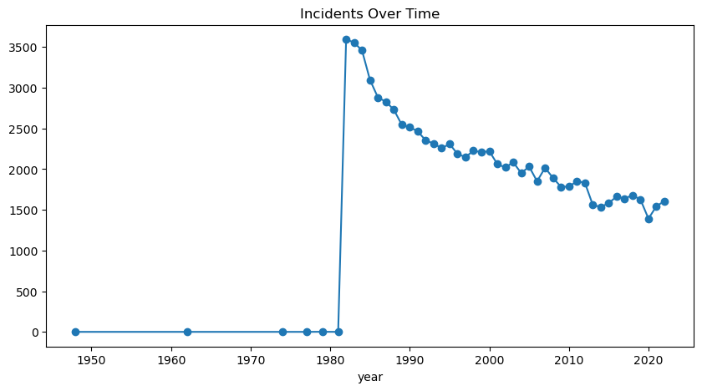
CONT’
Incident Trends Over Time
incident_trend = df.groupby('year').size()
incident_trend.plot(kind='line', marker='o', figsize=(10, 5), title='Incidents Over Time')

Slide 15
CONT’
2. Top Aircraft Models in Fatal Incidents
df[df['injury.severity'] == 'fatal’]
df['injury.severity'].unique()
fatal_models = df[df['injury.severity'].str.lower() == 'fatal']['model'].value_counts().head(10)
if not fatal_models.empty:
fatal_models.plot(kind='bar', figsize=(10, 5), title='Top Aircraft Models in Fatal Incidents’)
else:
print("No fatal incidents found in the dataset.")

Slide 16
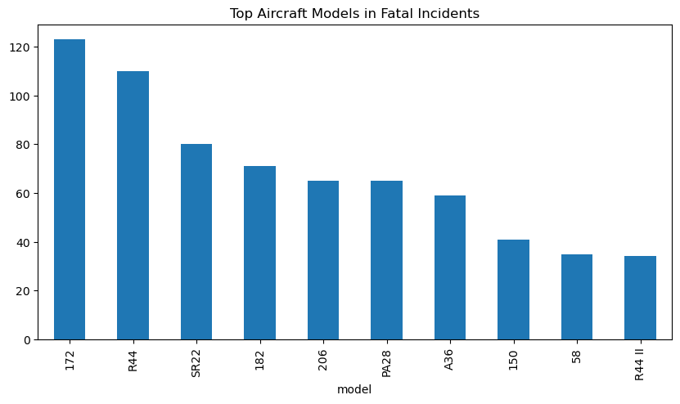
CONT’

Slide 17
CONT’
3. Engine Type vs Severity
pip install seaborn
import seaborn as sns
import matplotlib.pyplot as plt
import plotly.express as px
import pandas as pd
df = pd.read_csv("c:/Users/User/dsc-phase-1-project-v3/data/aviation_data.csv")
plt.figure(figsize=(10, 5))
sns.countplot(data=df, x='Engine.Type', hue='Injury.Severity’)
plt.title('Incident Severity by Engine Type’)
plt.figure(figsize=(8, 4)) # Width = 8 inches, Height = 4 inches

Slide 18
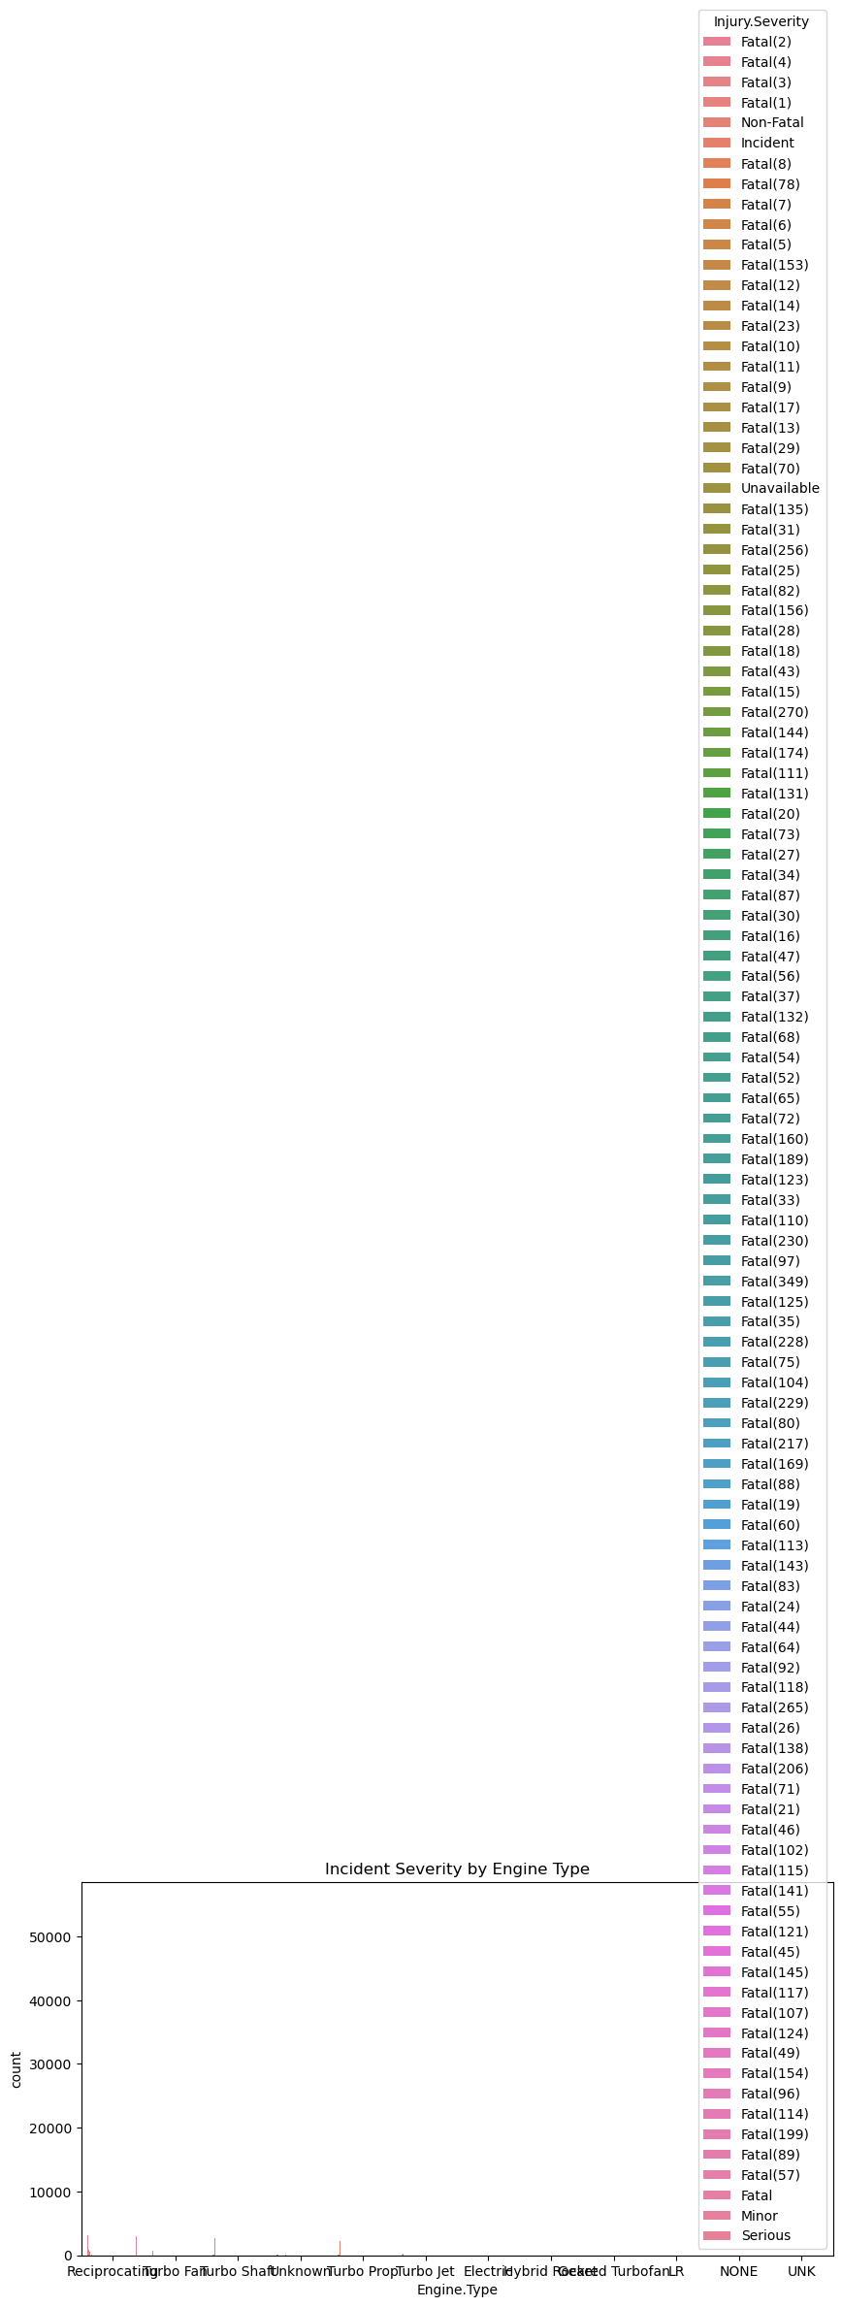
CONT’

Slide 19
CONT’
4. Region and the fatal incidences
Count incidents by country
country_counts = df['Country'].value_counts().reset_index()
country_counts.columns = ['Country', 'Incident_Count’]
Top 10 countries by incident count
top_countries = country_counts.head(10)
sns.barplot(data=top_countries, x='Incident_Count', y='Country’)
print(country_counts.head())

Slide 20
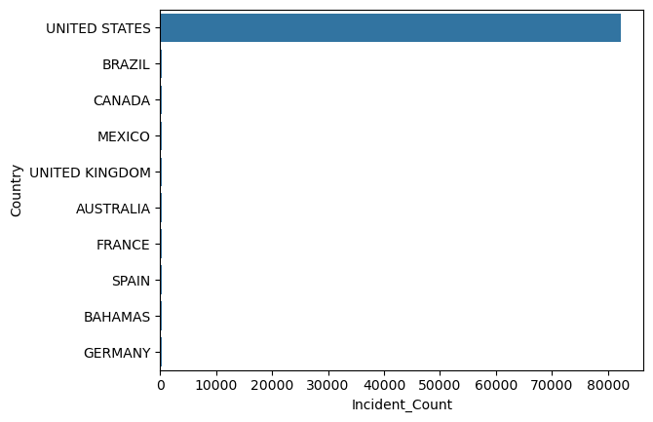
CONT’

Slide 21
CONT’
5. A relationship between aircraft Category and incident severity
Create aircraft type by combining Make and Model
df['Aircraft_Type'] = df['Make'] + " " + df['Model’]
Count incidents by aircraft type and severity
type_severity_counts = df.groupby(['Aircraft.Category', 'Injury.Severity']).size().reset_index(name='Incident_Count’)
pivot_df = type_severity_counts.pivot(index='Aircraft.Category', columns='Injury.Severity', values='Incident_Count').fillna(0)
Focus on top 10 aircraft types by total incidents
top_types = pivot_df.sum(axis=1).sort_values(ascending=False).head(10).index
filtered_df = pivot_df.loc[top_types]
filtered_df.plot.bar(stacked=True, colormap='Set2’)
plt.title("Incident Severity by Aircraft Type")
plt.ylabel("Incidents")
plt.xticks(rotation=45)
plt.show()

Slide 22
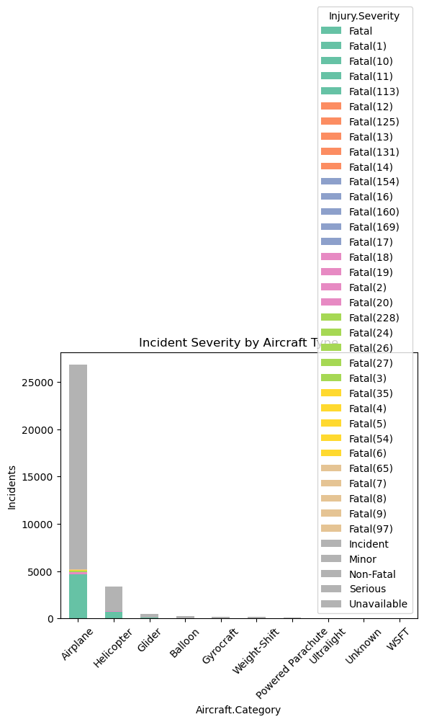
CONT’

Slide 23
CONT’
6. The correlation between weather patterns and incident severity
Groupby
weather_severity = aviation.groupby(['Weather.Condition', 'Injury.Severity']).size().reset_index(name='Incident_Count')
pivot_df = weather_severity.pivot(index='Weather.Condition', columns='Injury.Severity', values='Incident_Count').fillna(0)
pivot_df.plot(kind='bar', stacked=True)
plt.show()

Slide 24
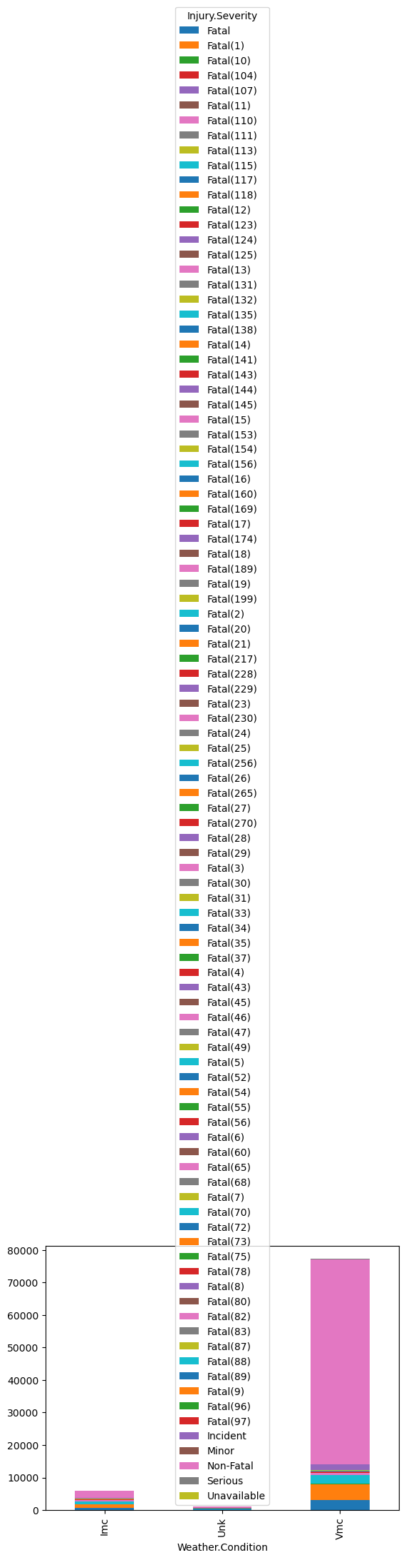
CONT’

Slide 25
CONT’
7. Aviation incidences in relation to amateur built aircrafts
Standardize the 'Amateur_Built' column for consistent analysis
aviation['Amateur.Built'] = aviation['Amateur.Built'].str.title().str.strip()
Incidence Counts
build_counts = aviation['Amateur.Built'].value_counts()
print(build_counts)
Group data by build type and injury severity, then count incidents
severity_by_build = aviation.groupby(['Amateur.Built', 'Injury.Severity']).size().unstack().fillna(0)
print(severity_by_build)
Create a stacked bar chart to visualize severity across build types
severity_by_build.plot(kind='bar', stacked=True)
plt.title("Severity by Build Type")
plt.show()

Slide 26
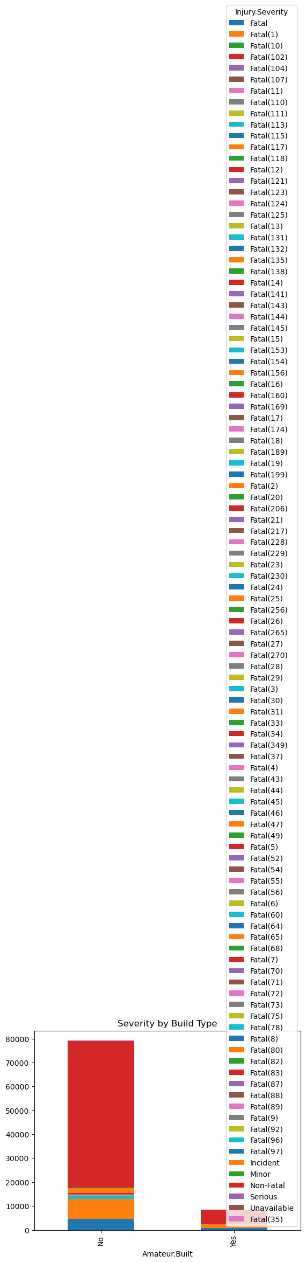
CONT’

Slide 27
Conclusion
Time Trends
• Incident frequency shows seasonal variation, with peaks during months of increased flight activity (e.g., summer and holiday seasons).
• Long-term trends suggest a gradual decline in total incidents, possibly due to improved safety protocols and technology—but fatal incidents persist, especially in general aviation.
Aircraft Models
• A small number of high-usage models (e.g., Cessna 172, Piper PA-28) account for a large share of incidents.
• These models are often used in training and private flights, which may correlate with less experienced pilots or less stringent maintenance oversight.

Slide 28
CONT’
Engine Types
• Single-engine aircraft are disproportionately represented in fatal and serious incidents.
• Turboprop and jet engines show fewer incidents per flight hour, suggesting better performance under stress and more robust safety systems.
Aircraft Categories
• Airplanes dominate the dataset, but helicopters and experimental aircraft show higher severity rates when incidents occur.
• Amateur-built aircraft have elevated risk profiles, often linked to mechanical failure or pilot error.
These insights can guide targeted safety audits, training programs, and engine modernization efforts.

Slide 29
Recommendations
Time-Based Safety Interventions
• Increase seasonal safety campaigns during high-traffic period, targeting private and recreational pilots.
• Use historical incident data to forecast risky periods and allocate inspection resources accordingly.
Model-Specific Oversight
• Conduct targeted audits and maintenance reviews for frequently involved models like the Cessna 172.
• Encourage manufacturers to analyze incident data and improve design or training materials for high-risk models.
Engine-Type Risk Mitigation
• Mandate additional training for pilots operating single-engine aircraft, especially in adverse weather conditions.
• Promote engine redundancy upgrades or enhanced emergency protocols for older single-engine fleets.
Aircraft Category Focus
• Require stricter certification and inspection for amateur-built and experimental aircraft.
• Develop category-specific safety dashboards for regulators to monitor trends and intervene early.

Slide 30
Note
How to run
Open the notebook in Jupyter and run all cells top to bottom. No external dependencies beyond pandas, seaborn, and matplotlib.

